Slide 1
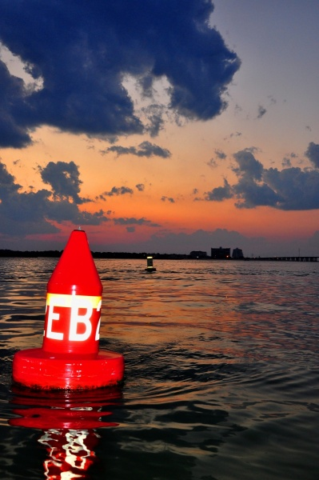
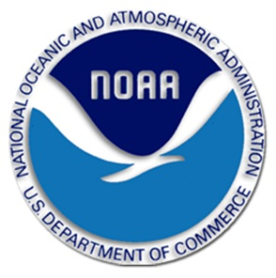
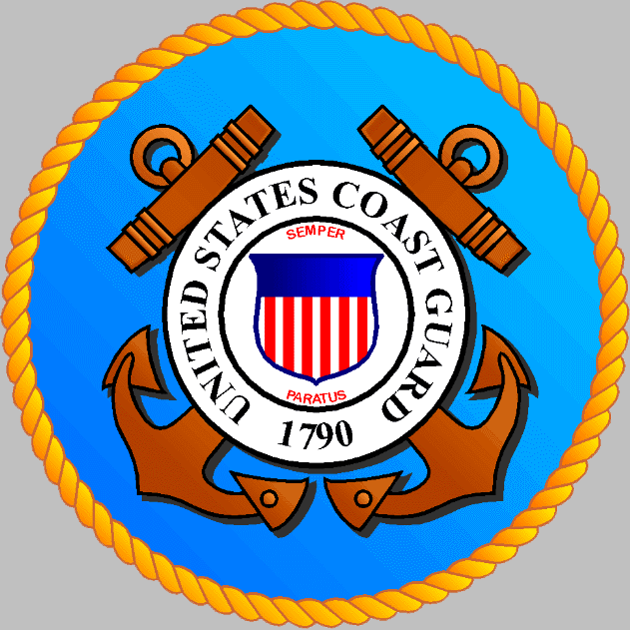
CAPT Mark Ogle COMMANDER, SECTOR HAMPTON ROADS
Hydrographic Services
Review Panel
2011
Notes:
Introduce yourself. My presentation today is on the working relationship between NOAA and the Coast Guard. Our working relationship has traditionally focused on Waterways Management issues and will probably continue to do so. I plan to talk about how we work together and a new “Partnership Initiative” and how we can strengthen our relationship. Can we be more effective and efficient? How can we help each other?

Slide 2
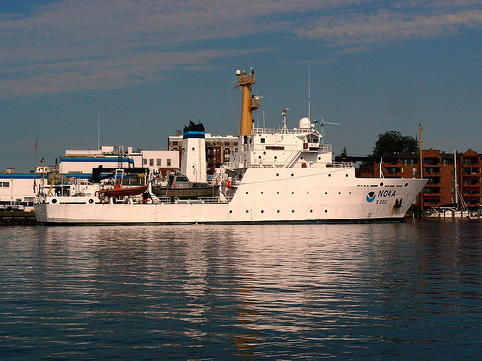
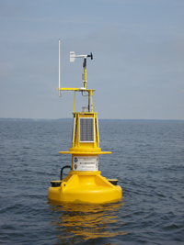
PORT OF HAMPTON ROADS
Partnership Examples
Severe Weather Plan
Pre/Post storm surveys
Buoy data
OPSAIL
Annual Surveys?

Slide 3
USCG ORGANIZATION
COMDT
Deputy Commandant
for Mission Support
(DCMS)
Deputy Commandant
for Operations
(DCO)
Commander,
Atlantic Area
Operational Command
(OPCOM)
5TH DISTRICT
Sectors
Air Stations
North Carolina
Elizabeth City
Delaware Bay
Baltimore
Hampton Roads
Atlantic City
Commander,
Pacific Area
Force Readiness Command
(FORCECOM)
Notes:
3
Here’s a quick snapshot of our organization. Our “Regional” operational commanders are Districts. The Coast Guard Districts correlate to Army Corps Divisions . Below the District are our “Field Units”.

Slide 4
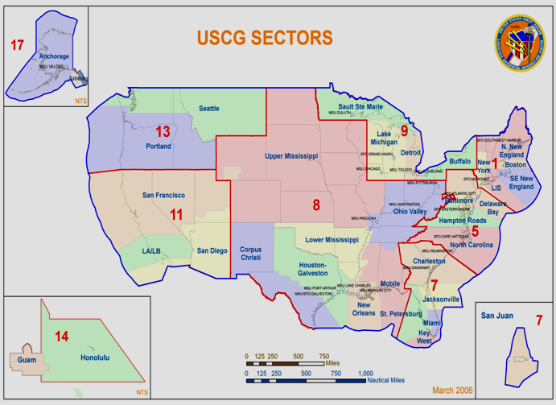
Who We Are?
Notes:
Provide a quick overview of the location of 9 Districts and 35 Sectors.

Slide 5
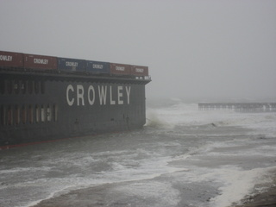
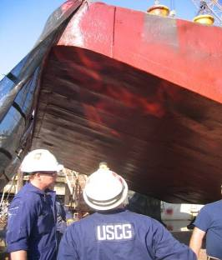
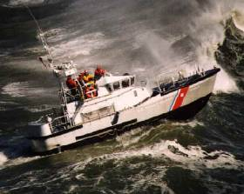
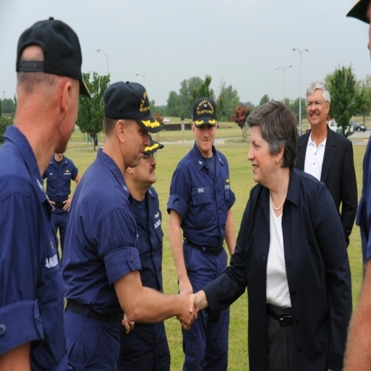
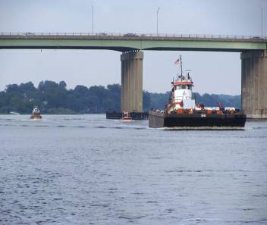
Authorities
Federal On Scene Coordinator
Search & Rescue Mission Coordinator
Captain of the Port
Federal Maritime Security Coordinator
Officer in Charge of Marine Inspections
Officer In-charge of Marine Inspections
Notes:
Managing a port with a multitude of users can be difficult: the Navy, commercial shipping and recreational boaters have different demands and expectations. So it helps to have some regulatory titles with authority to make decisions.
Unfortunately, somebody got a little carried away assigning titles. But, let’s take a look. Review the responsibilities associated with the titles.

Slide 6
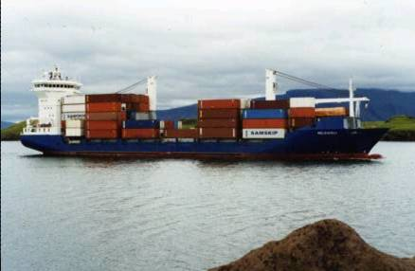
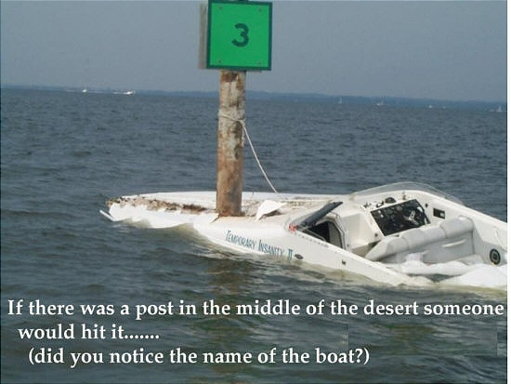
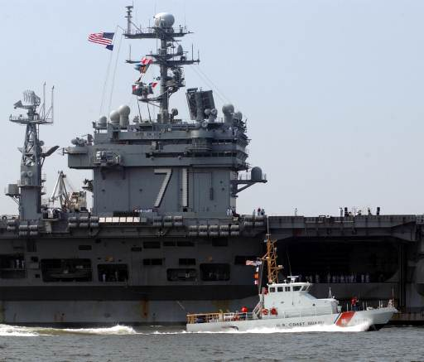
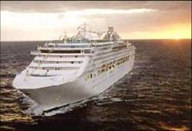
Competing Port Interests
Over 250,000 registered recreation Vessels in Virginia
$112 Million a Day in Cargo
Largest Naval Base In the world
Notes:
6
Since we are both in the business of managing ports and supporting use of waters for recreation and commerce, I would like to provide you insight into the world of work we deal with in our ports from a Coast Guard perspective.
Some of the Challenges…
Escorts of Navy ships from the largest US Naval base in the world…over 2,500 movements a year.
An average month has more than 240 foreign and domestic deep draft vessels calling on Port of Hampton Roads. This number is also projected to increase once the new APM Maersk terminal is finished????
A growing Cruise Ship industry… Nauticus is proof of that. In one month an average of 3 cruise ships call on Hampton Roads with over 42,000 pax this past year.
In 2010 over 1,900,000 inter-modal shipping containers passed through the Port of Hampton Roads.
We typically have 1300+ SAR, LE and Port Security incidents for response.

Slide 7
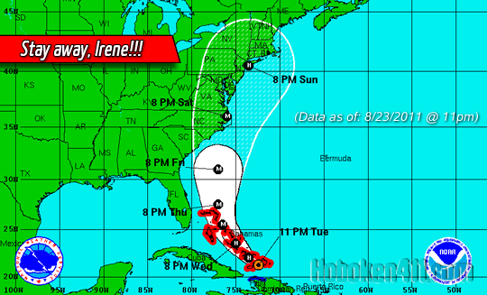
Hurricane Irene
Originally predicated as a CAT 3
Large scale Naval vessel sortie
Port Closed at 8:00 PM on August 26th
Notes:
Predicted as a Category 3 – hit land as a Category 1
Area was prepared for the one of the worst storms in history
The Navy departed over 30 vessels in less than 3 hours

Slide 8
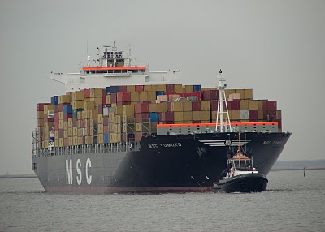
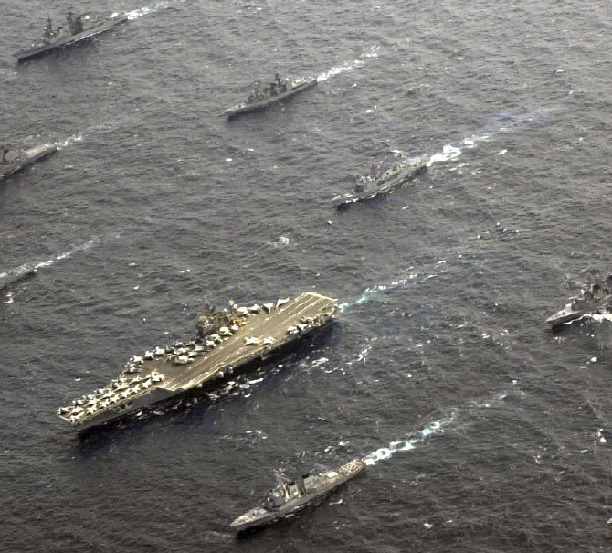
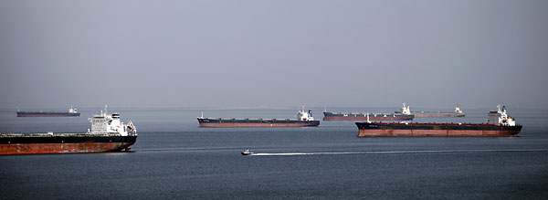
Efficient port recovery
Aids to Navigation
Container vessels Over 30 Naval vessels
Coal ships
Notes:
Challenges –
38 Naval vessels needed to return to Norfolk
No ships at any of the container facilities or coals piers which equals a stalled local economy for the Port of Hampton Roads
Vessels must enter/depart Port of Hampton Roads AOR to reach Baltimore’s AOR – therefore if we are not open, neither are they
Again - with the outstanding partnership of the ACOE, we jointly ensured the channels were clear prior to opening the port, cleared issues such as shoaling, buoys off stations, and a myriad of bridge/lock failures.
Port partially reopened at 1700 on August 28th (with restrictions) - containers vessels were waiting at the pier on Monday morning waiting for the workers to return. The Navy safety returned all of their vessels and coal ships were once again stacked up at anchorage waiting their turn to load.
Let me just say that it is not typical for a port to be able to reopen only 16 hours following the passing of a hurricane but due to our ability to work together and to know each others capabilities we were able to do it.

Slide 9
Partnership Goal - Trident
Unified mapping command
Identify/survey critical corridor
Homeland Security
Offshore wind/energy – PARS
2014 Panama Canal expansion
Leverage funds/assets for MTS
Marine Environmental Response

Slide 10
Opportunities -
Channel & Anchorage Maintenance (recent Elizabeth river survey/dredging)
ATON Coordination
New Constructions Permits
Wreck/Debris Removal
Waterways Utilization Data
Marine Transportation System Recovery
Natural Disasters (salvage, clear channel)
Harbor Safety Committees
Exercises
Notes:
We should already be cross-briefing or working on a number of areas as shown. (Discuss as needed.)
ATON COORDINATION – Action Item #4
This goes hand-in-hand with Army Corps responsibility for Federal Channel and Anchorage maintenance. What information can we share with these jobs? How do you see us helping each other?
WRECK STATUS & REMOVAL – Action Item # 5
Larry’s Note: The USACE is authorized/required to remove wrecks in the Federal maintained channels and anchorages iaw 33 CFR 245. But sometimes we can share resources to remove wrecks that are a hazard to navigation located outside channels. I’ve seen this with local Police divers and Army divers; USACE lifting capabilities and deck barge; and state/fed funding for disposals or shoreside dumpsters.
MTSR – Recovery of Marine Transportation System for Resumption of Commerce
Facilitate the Marine Transportation System Recovery (MTSR) following a significant transportation disruption
Part of the National Incident Management System (NIMS)
- Ensures high level coordination between the Coast Guard, other Federal agencies, and the private sector for MTS recovery and expeditious
resumption of trade
EXERCISES - Action Item #11
We can offer you folks opportunities to engage in exercises. How much do you want? We can also offer to share Incident Command System (ICS) training.
So, let’s look at some more.

Slide 11
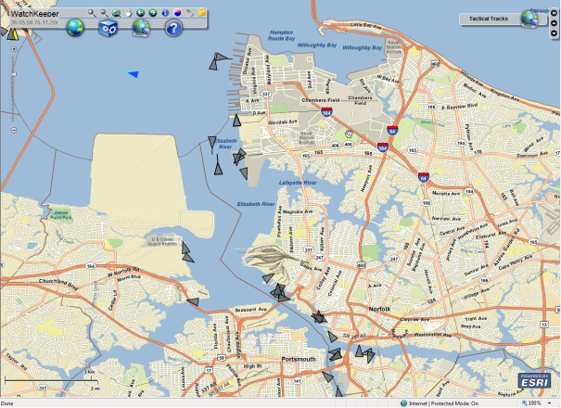
Opportunities
Interagency Operations Center (IOC)
The SAFE Port Act of 2006 mandated the establishment of IOCs to better plan, coordinate, and execute maritime security operations among interagency partners.
USCG developed “Watchkeeper” to facilitate a web-based virtual IOC.
Notes:
The Coast Guard has a requirement to support the Interagency Operations Center in our ports. We know that most agencies have no interest in sitting in a command center with us, so the idea of a virtual operation center would allow us the venue to share information electronically.
The IOC is an easy way to share information or sensory data of interest.

Slide 12
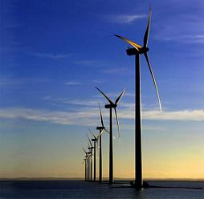
Opportunities
Offshore Wind Energy Initiative Impact on Port and Navigation
Gov. McDonnell’s vision to make Virginia the "energy capital of the East Coast" and the first to produce energy offshore.
Two competing proposals for wind farms -both located 12 miles off of Virginia Beach due to only mid-atlantic high voltage sub-station - Camp Pendelton.
The Virginia Offshore Wind Coalition estimates that the development of a wind power hub in Virginia has the potential to become an $80 billion industry creating more than 10,000 jobs, including a significant maritime component.
Notes:
Is there a state that isn’t looking at wind energy initiatives?
The Coast Guard has policy guidance for our port level commanders that outlines our agency’s concerns for navigation and safety issues. NVIC 02-07 outlines application handling procedures for wind farms, and operational requirements that the Coast Guard will recommend for their operation. [Example: Remote shutdown for Search & Rescue.] It also outlines navigation concerns like radar detection across a “farm” of wind posts.

Slide 13
Questions?

